Slide 1
CS5551 Advanced Software Engineering Agile Process Model: Scrum
Reference: Software Engineering: A Practitioner’s Approach, 6/e and are provided with permission by R.S. Pressman & Associates, Inc., copyright © 1996, 2001, 2005

Slide 2
Agile Process
An “Agile” process focuses on rapid, incremental delivery of software
Agile manifesto:
Individuals and interactions over processes and tools
Working software over comprehensive documentation
Customer collaboration over contract negotiation
Responding to change over following a plan

Slide 3
What is Scrum?
Scrum [Jeff Sutherland, 1993]
An iterative incremental process commonly used with agile software development
A set of practices and predefined roles.
The main roles in Scrum:
Scrum Master maintains the processes and works similar to a project manager,
Product Owner represents the stakeholders (clients, end users)
Team includes the developers.
Source: http://scrum.jeffsutherland.com/

Slide 4
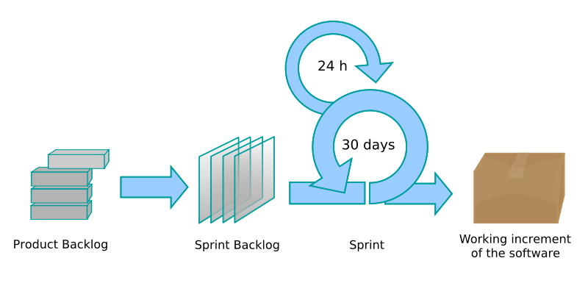
Scrum Process Flow
Starting Scrum
Create Product Backlog
Write Use Cases (or acquire stories)
Initial estimate of effort
source: http://blog.3months.com/2010/01/10/illustrating-scrum-a-new-and-improved-scrum-diagram/

Slide 5
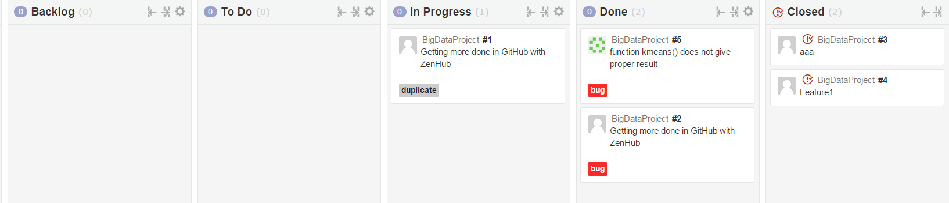
Example: ZenHub: Scrum Process

Slide 6
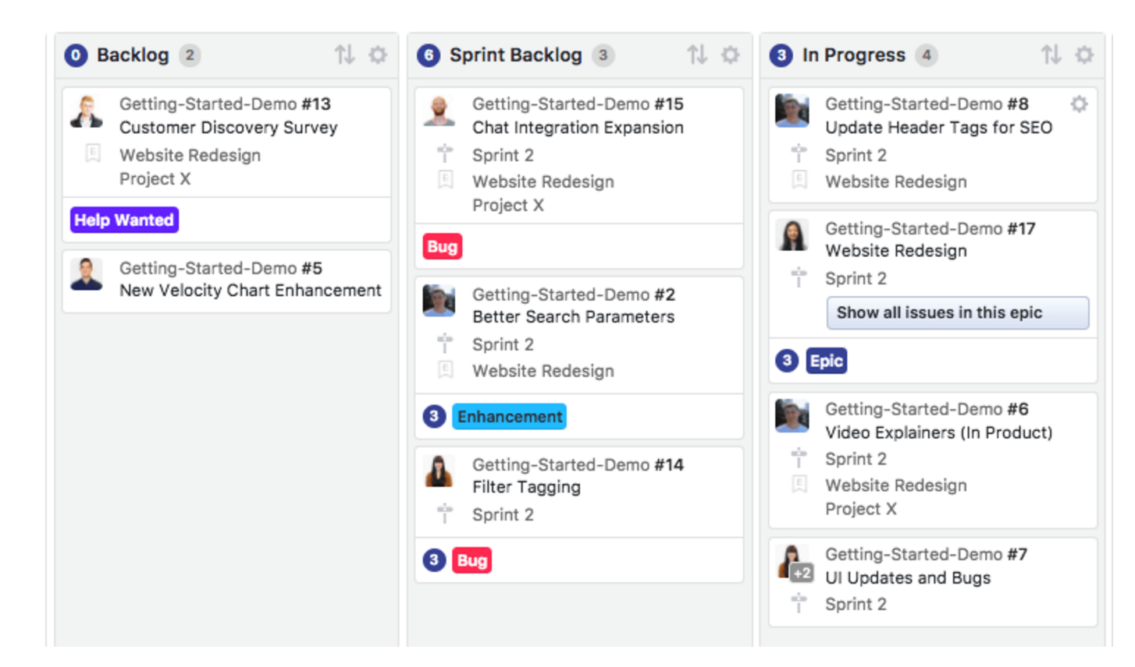
Example: ZenHub: Scrum Process
https://www.zenhub.com/guides/zenhub-tour

Slide 7
Scrum Process Flow
Planning Product owner and team decide which stories are actually feasible to be moved from the Product backlog to the Sprint backlog.
Sprint (“increment”)
The team is left alone to perform the user stories which it has committed itself in the planning meeting.
The product owner may attend the “daily scrums” if a granular status update is desired.
Review The team presents its work and verifies what it has done indeed satisfies the utmost desires of the product owner.

Slide 8
Daily Scrum
Short (~15 minute) meeting each day
Everyone on team attends
Everyone remains standing
Each member reports exactly 3 things:
What they got done since last meeting
What they are planning to finish by next meeting
Any blocks or impediments
Source: http://scrum.jeffsutherland.com/

Slide 9
User Stories - Structure
Who (user role) – is this a customer, employee, system administrator?
What (goal) – What is the specific functionality that is to be achieved or developed?
Why (reason) – Helps the developer to understand the broader scope of the story and eliminate any ambiguities that may arise.
Putting it all together:
As a [user role], I want to [goal], so I can [reason].
E.g., “As a registered user, I want to log in, so I can access subscriber content.”
Source: http://www.agileforall.com/2009/05/new-to-agile-invest-in-good-user-stories/

Slide 10
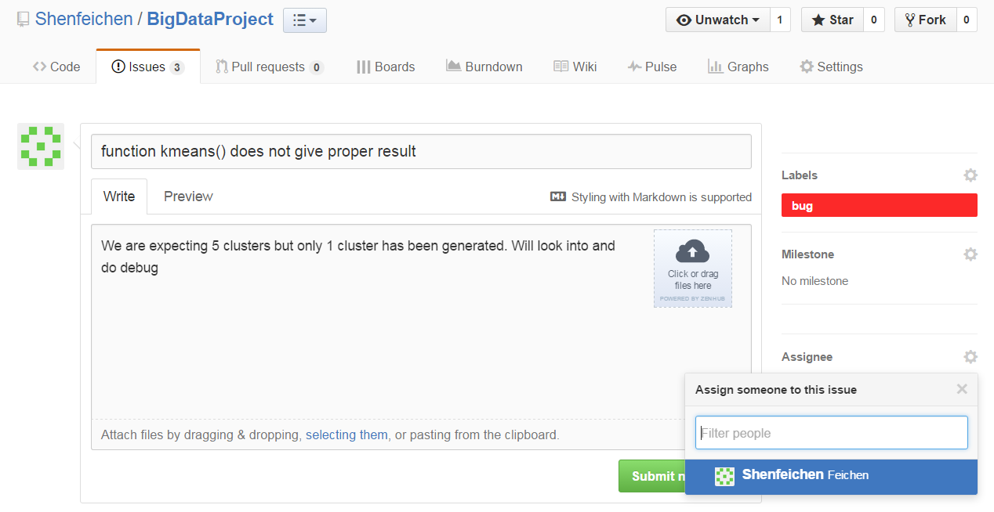
Example: ZenHub: Issue (Story)

Slide 11
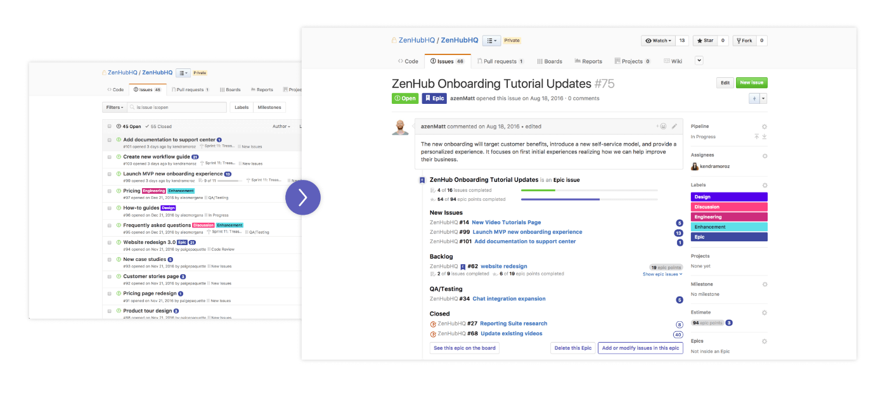
Example: ZenHub: Epics/Issue
ZenHub Epics add a crucial layer of hierarchy to your GitHub Issues.
- control end-to-end over the release process.
- bundle similar tasks into themes of work
- a “user story” is the smallest unit of work,
- an Epic is essentially a “big” user story.
https://www.zenhub.com/guides/zenhub-tour

Slide 12
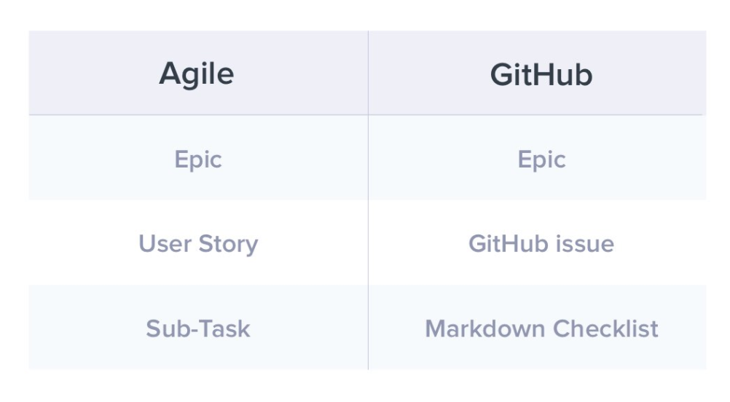
Example: ZenHub: Epics/Issue
ZenHub Epics add a crucial layer of hierarchy to your GitHub Issues.
- a “user story” is the smallest unit of work,
- an Epic is essentially a “big” user story.
- GitHub issue is a user story
https://www.zenhub.com/guides/getting-started-with-epics-in-zenhub

Slide 13
User Stories – I.N.V.E.S.T.
Independent - For some systems, it's near impossible to make each feature completely independent. User Stories should be as independent as possible.
Negotiable - User Stories are not a contract. They are reminders of features for the team to discuss and collaborate to clarify the details near the time of development.
Valuable - User Stories should be valuable to the user (or owner) of the solution. They should be written in user language. They should be features, not tasks.
Estimatable - User Stories need to be possible to estimate -- enough information to estimate, without being too detailed.
Small - User Stories should be small. Not too small. But not too big.
Testable - User Stories need to be worded in a way that is testable, i.e. not too subjective and to provide clear details of how the User Story will be tested.
Source: http://www.agileforall.com/2009/05/new-to-agile-invest-in-good-user-stories/

Slide 14
Effort Estimation (1)
Points as a measure of effort:
Effort refers to amount of work
Units are time-based, e.g., person-days
Usual definition is
1 point = 8 hours (perfect person-day)
Velocity is based on number of hours available. Rule of thumb is about 75%, so ~6 hours of an 8 hour day.
Source: http://deepscrum.wordpress.com/2009/11/12/a-brief-defense-of-time-estimating-sizes-for-scrum-projects/

Slide 15
Effort Estimation (2)
Points as a measure of complexity:
No standard means to define complexity
Use a relative scale, sometimes compared to t-shirt sizes etc.
Velocity is based on team history
By default, ZenHub comes pre-loaded with 8 default story point estimates: 1, 2, 3, 5, 8, 13, 21, and 40.
Any Issue that you want to estimate with an 21 or higher, velocity charts can be considered potentially too very complex.
https://www.zenhub.com/guides/your-first-sprint-using-zenhub#estimating-sprint-work
Source: http://deepscrum.wordpress.com/2009/11/12/a-brief-defense-of-time-estimating-sizes-for-scrum-projects/

Slide 16
Scrum Artifacts
Product Vision
Product Backlog
Release Plan
Sprint Backlog
Sprint Burndown
Sprint Report (story, design, list of implementation and test cases, obstacles)
A sprint is a get-together of people involved in a project to give a focused development on the project. Sprints are typically two to seven days long.

Slide 17
Product Vision
Ensure that you have a good understanding of client’s goals
Product vision is included in your requirements document (“proposal”)
Brief client and product description is also included in “proposal” and “plan report”

Slide 18
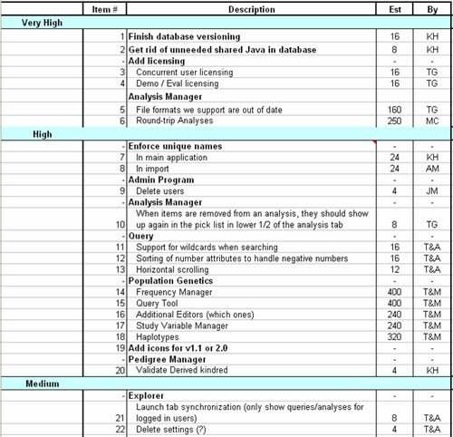
Product Backlog
Should include:
Item description
Priority
Point estimate
Name of use case or story
Many varieties, this one from:
http://epf.eclipse.org/wikis/scrum/Scrum/workproducts/product_backlog_68345C16.html

Slide 19
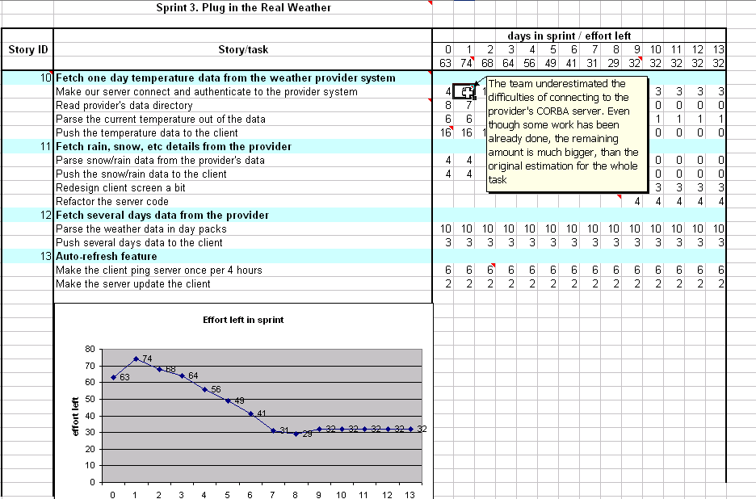
Release Plan/Sprint Backlog
Subset of the Product Backlog in current release
Includes additional detail about tasks
http://www.agile-tools.net/backlog.asp

Slide 20
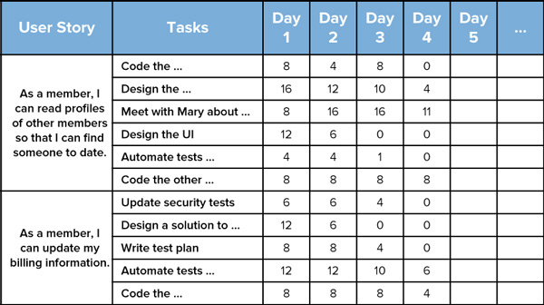
Sprint Backlog – another example
http://www.mountaingoatsoftware.com/scrum/sprint-backlog

Slide 21
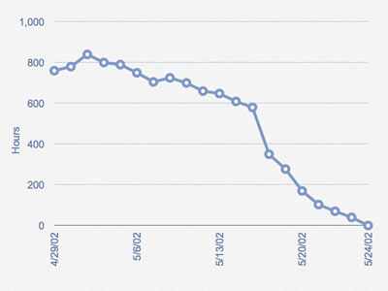
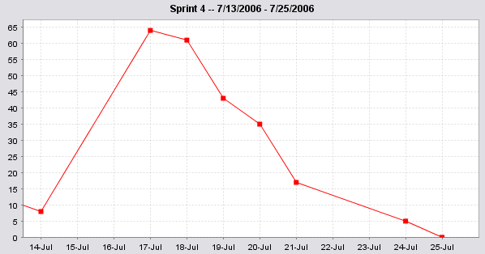
Sprint Burndown
A burn down chart is a graphical representation of work left to do versus time.
It is useful for predicting when all of the work will be completed.
(measurable progress over time)
http://kanemar.com/2006/11/07/seven-common-sprint-burndown-graph-signatures/

Slide 22
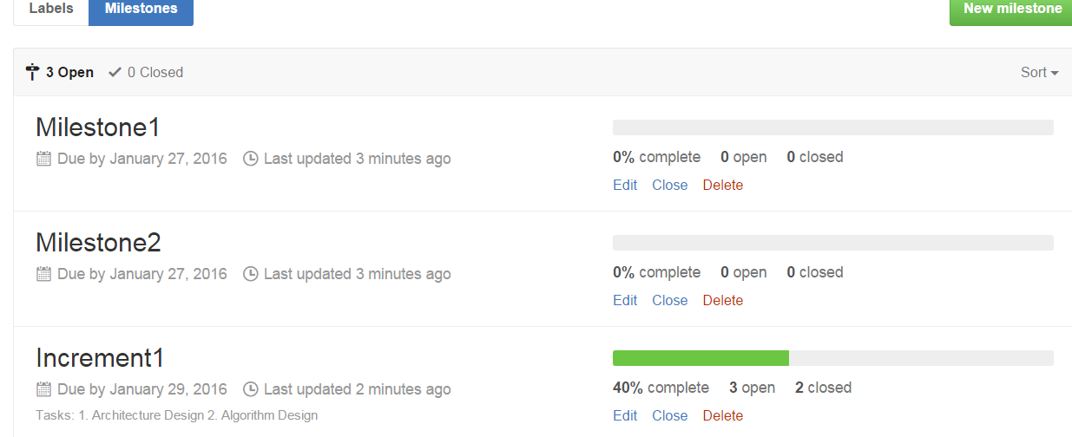
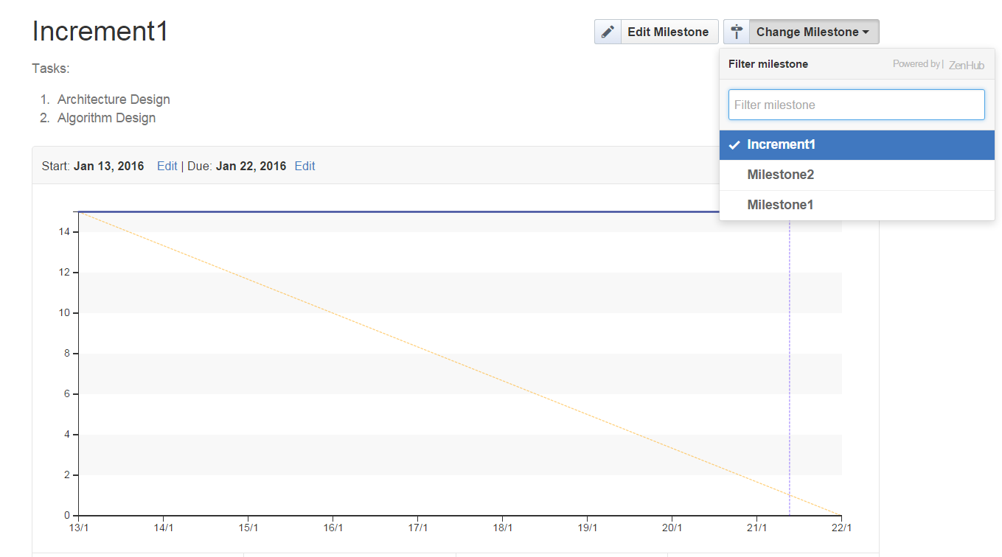
ZenHub: Milestone & Burndown Chart

Slide 23
Additional References
Schwaber, Ken and Mike Beedle. Agile software Development with Scrum. Prentice Hall, 2002.
Sutherland, Jeff. “Inventing and Reinventing Scrum in five companies”, 21 September 2001
www.controlchaos.com/scrumwp.htm
www.agilescrum.com/
www.mountaingoatsoftare.com/scrum/
www.objectmentor.com
agilealliance.com/articles/articles/InventingScrum.pdf
http://scrum.jeffsutherland.com/

